Slide 1
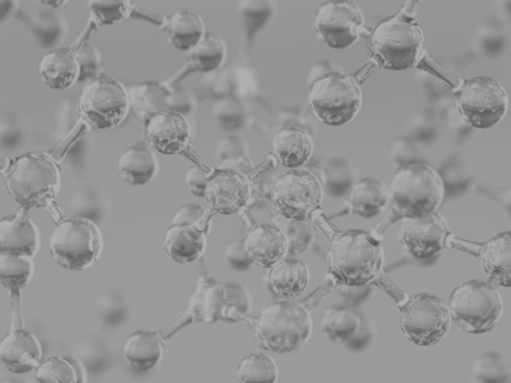


Week 4
Onboarding – Feature Engineering
Zachary Chang
University of California, Los Angeles (UCLA)
Contact: zachang890@g.ucla.edu
Physics of AmoRphous and
Inorganic Solids Laboratory

Slide 2
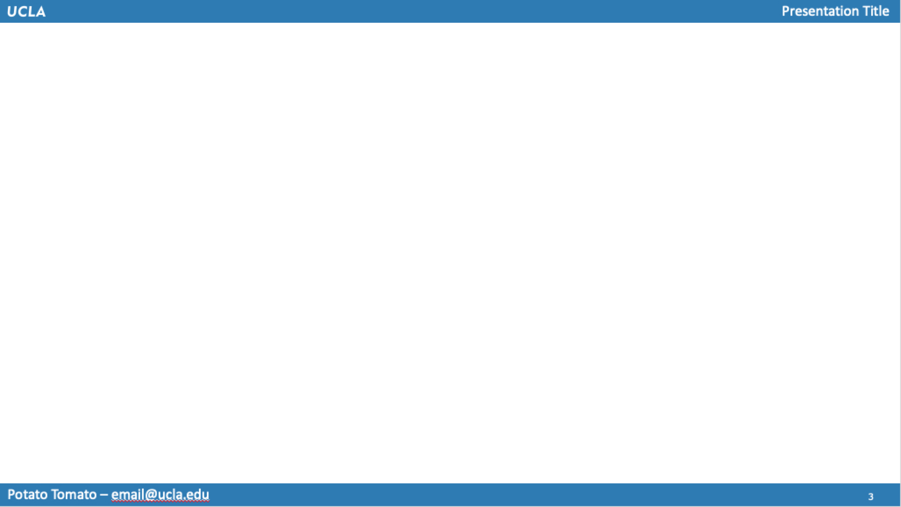

Background & Motivation/Goal
Data Provided: 1603 data points, Compound to element compositions [ex. Al₂O₃ = 2 Al + 3 O]
Type of Data (Relevant): Given chemical compound composition (compound mol %) & Young’s Modulus, Shear Modulus, and Poisson’s Ration
Goal for the Week: Familiarize with data & write functions to find weighted averages for relevant features & begin using RandomForestReg. & LASSO

Slide 3
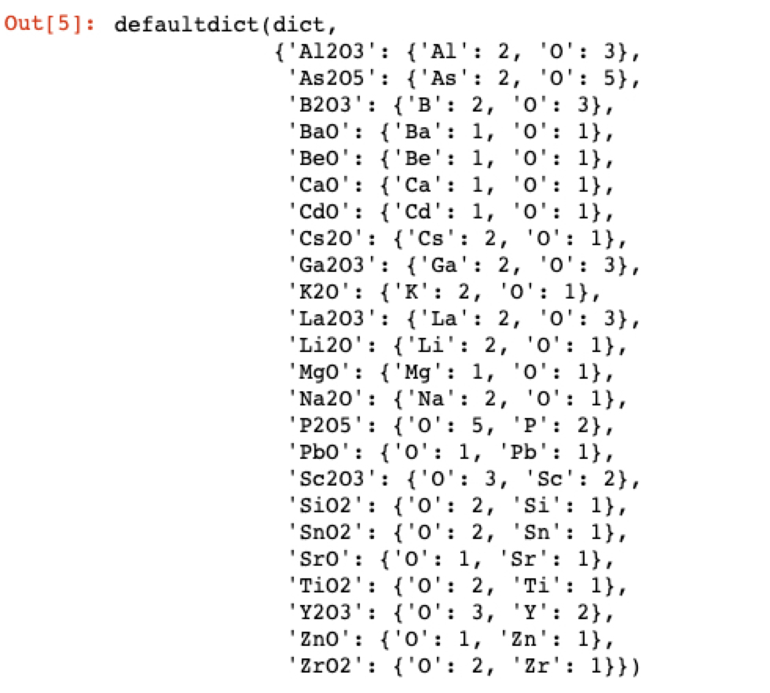
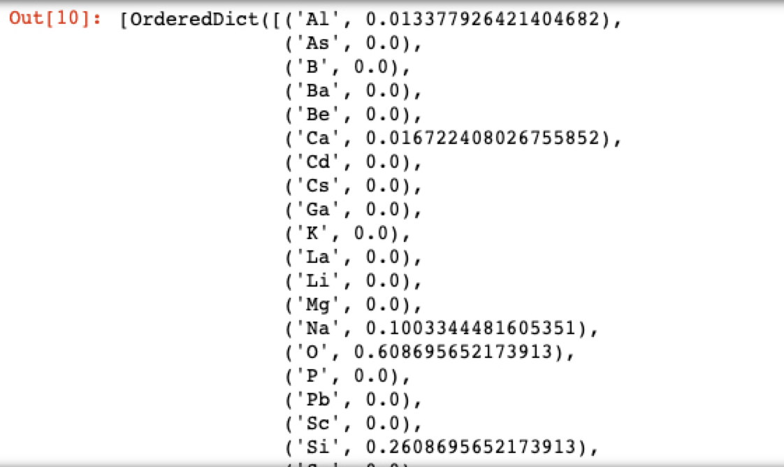
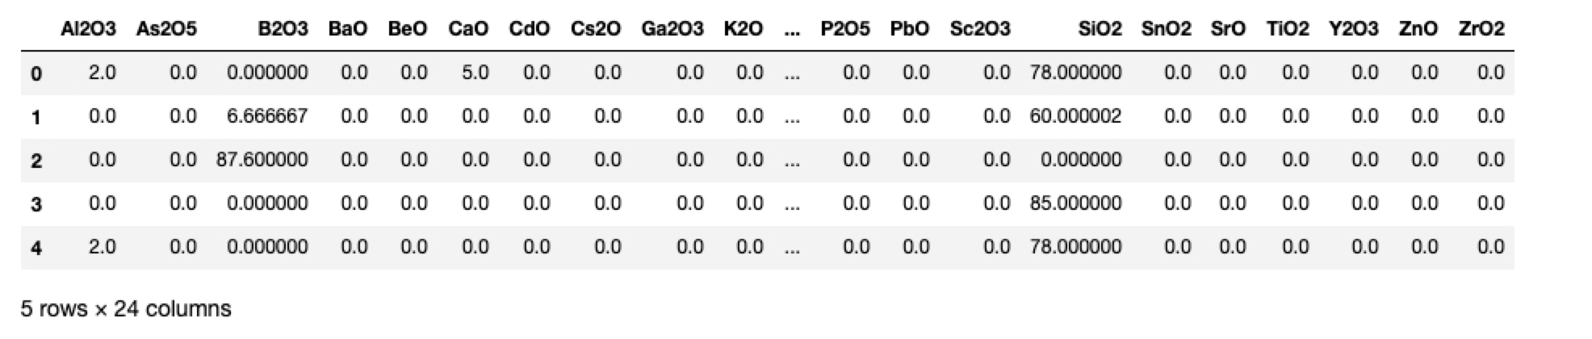
Process: Extract Atomic Mol %
Excerpt from N x P matrix of atomic mol %
[per-element weighted avg.]
Dictionary of makeup of chemical compounds
Use compound mol % values to construct a 1603 x 25 matrix where 1603 = number of glass samples and 25 = number of elements → matrix values are atomic mol % for each glass sample
Dictionary of makeup of chemical compounds

Slide 4
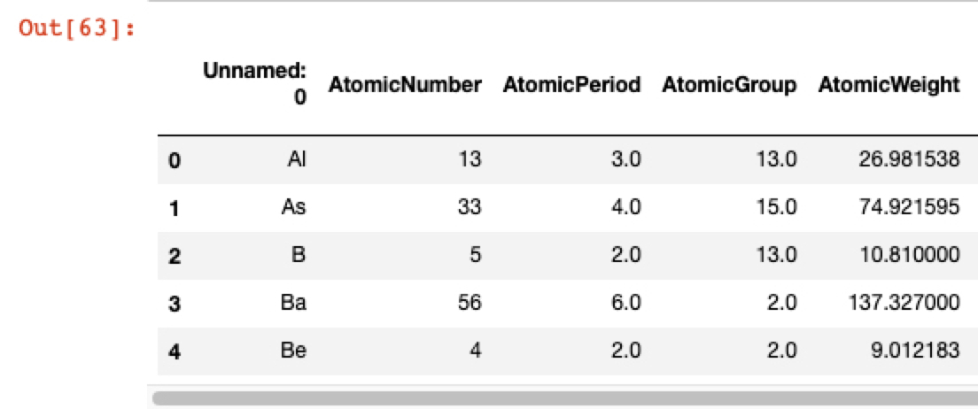
Feature Transformation
X
1603 x 25 Matrix with each glass sample’s atomic mol %
Introducing 25 x 12 Matrix with relevant features
Result: 1603 x 12 Matrix → weighted features

Slide 5
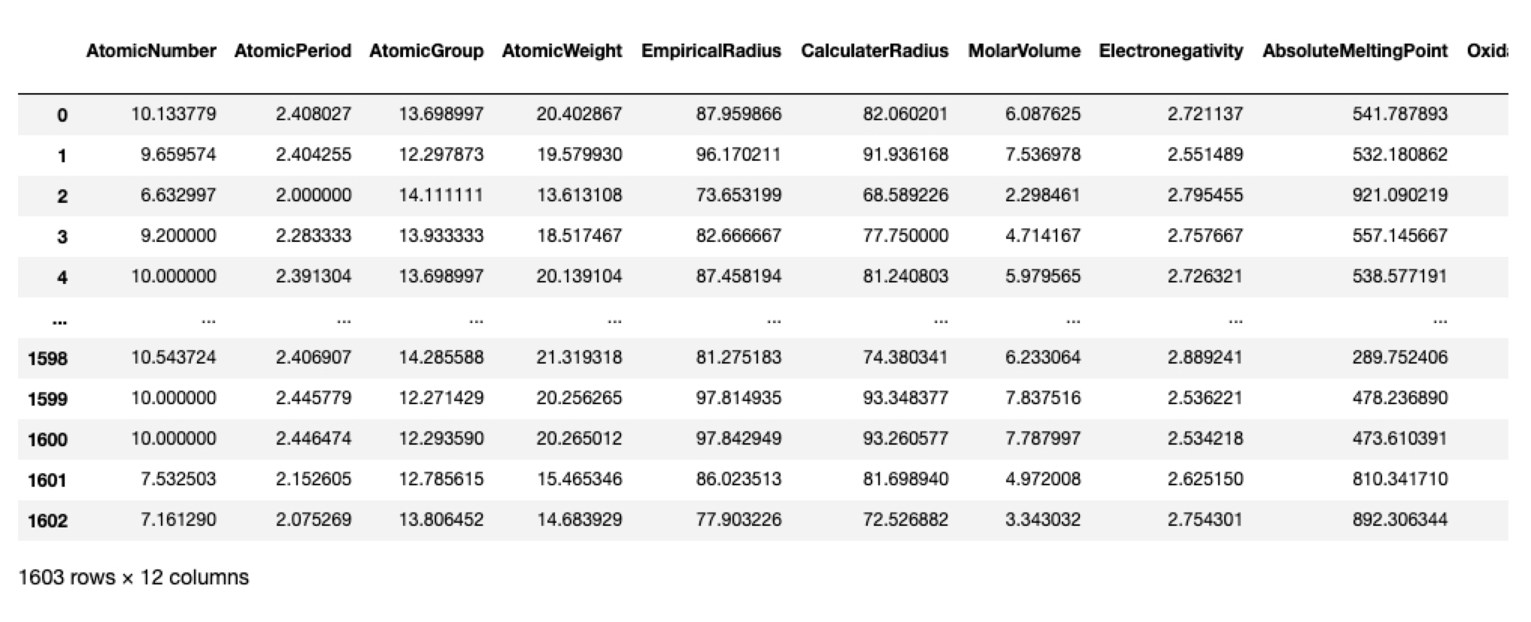
Weighted Features
Resulting Matrix

Slide 6
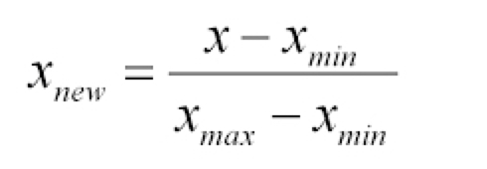
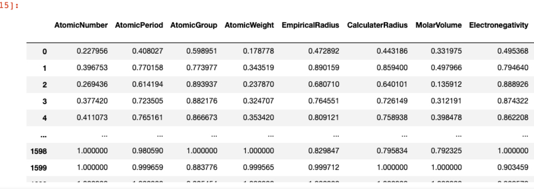
Feature Normalization
Basic Normalization function (bounds data in interval [0,1])

Slide 7
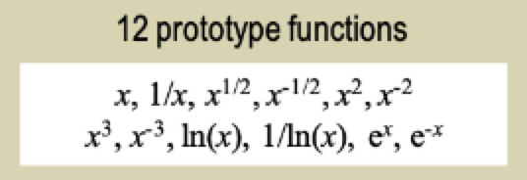
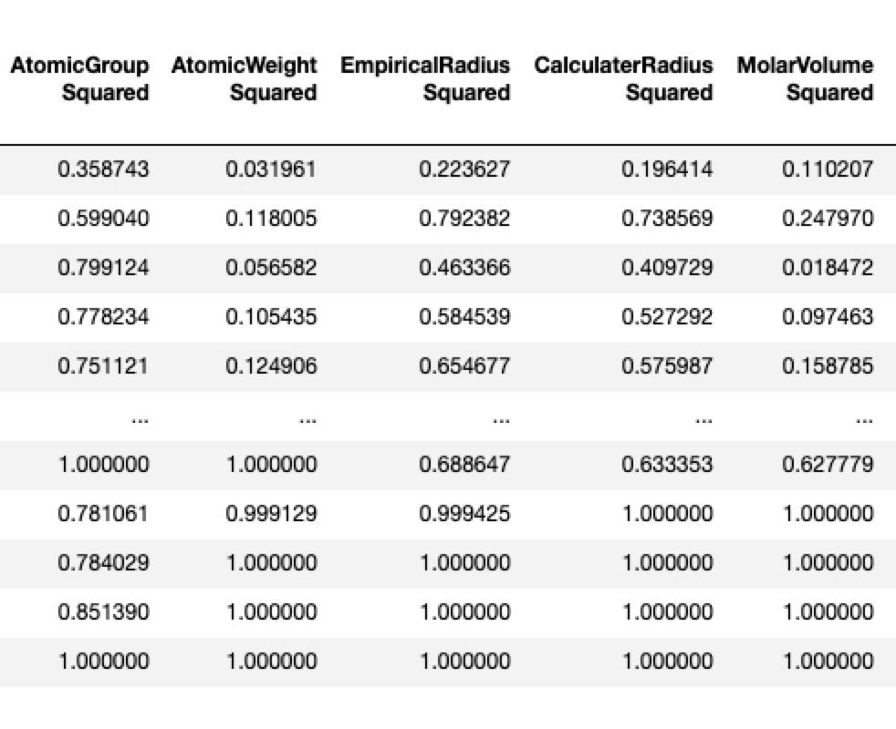
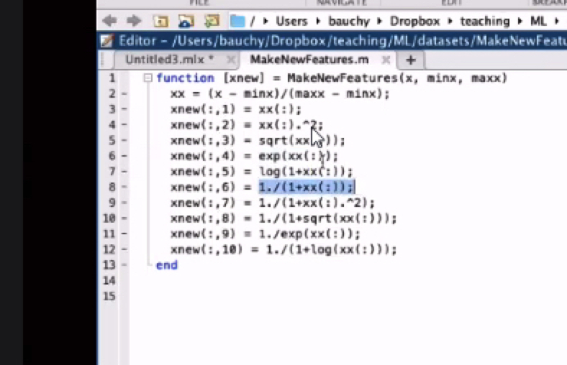
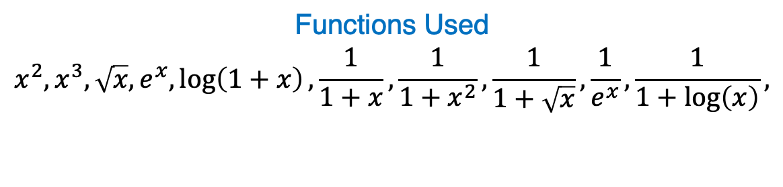
Transformations
From Paper
List of transformations Used:
Functions Used
$$x^{2}, x^{3}, \sqrt{x}, e^{x},\log\left(1+x\right),\frac{1}{1+x},\frac{1}{1+x^{2}},\frac{1}{1+\sqrt{x}},\frac{1}{e^{x}},\frac{1}{1+\log\left(x\right)},$$
Sample
From Video

Slide 8
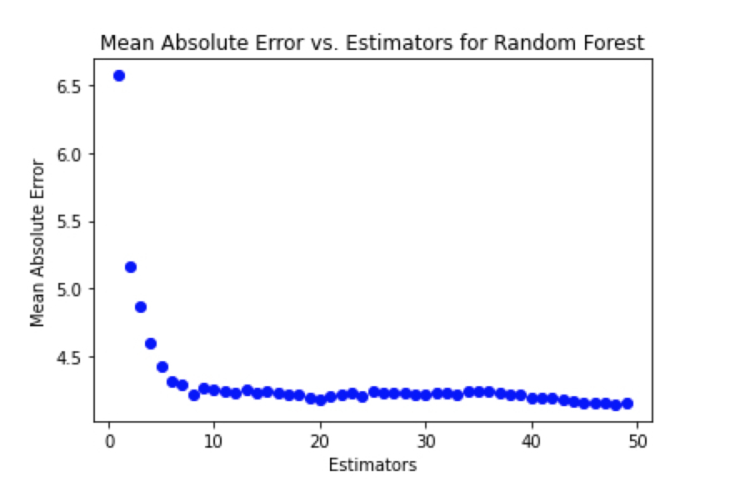
Random Forest Trial (w/o Feature Selection) – Young’s Modulus
List of transformations Used:

Slide 9

Conclusion: Next Steps
List of transformations Used:
Perform RandomForestRegression for shear modulus and Poisson’s ratio
Use LASSO to perform feature selection from 1st level mathematical transformations
Repeat RandomForestRegression with newly picked features
Organize into functions and classes
Look at CS 111 Reading notes for tips on what to improve here

